Slide 1

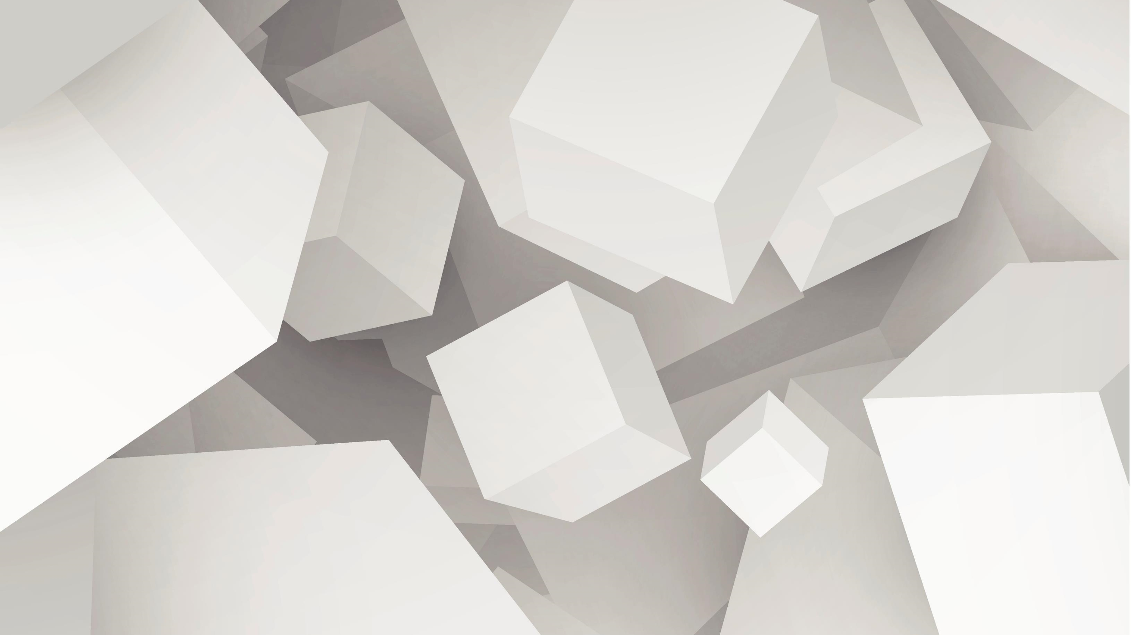
Smart Bottle
By Tomer Erusalimsky
208667162
The College Of Management
Made for the IOT course by Yehuda Rozilyo

Slide 2
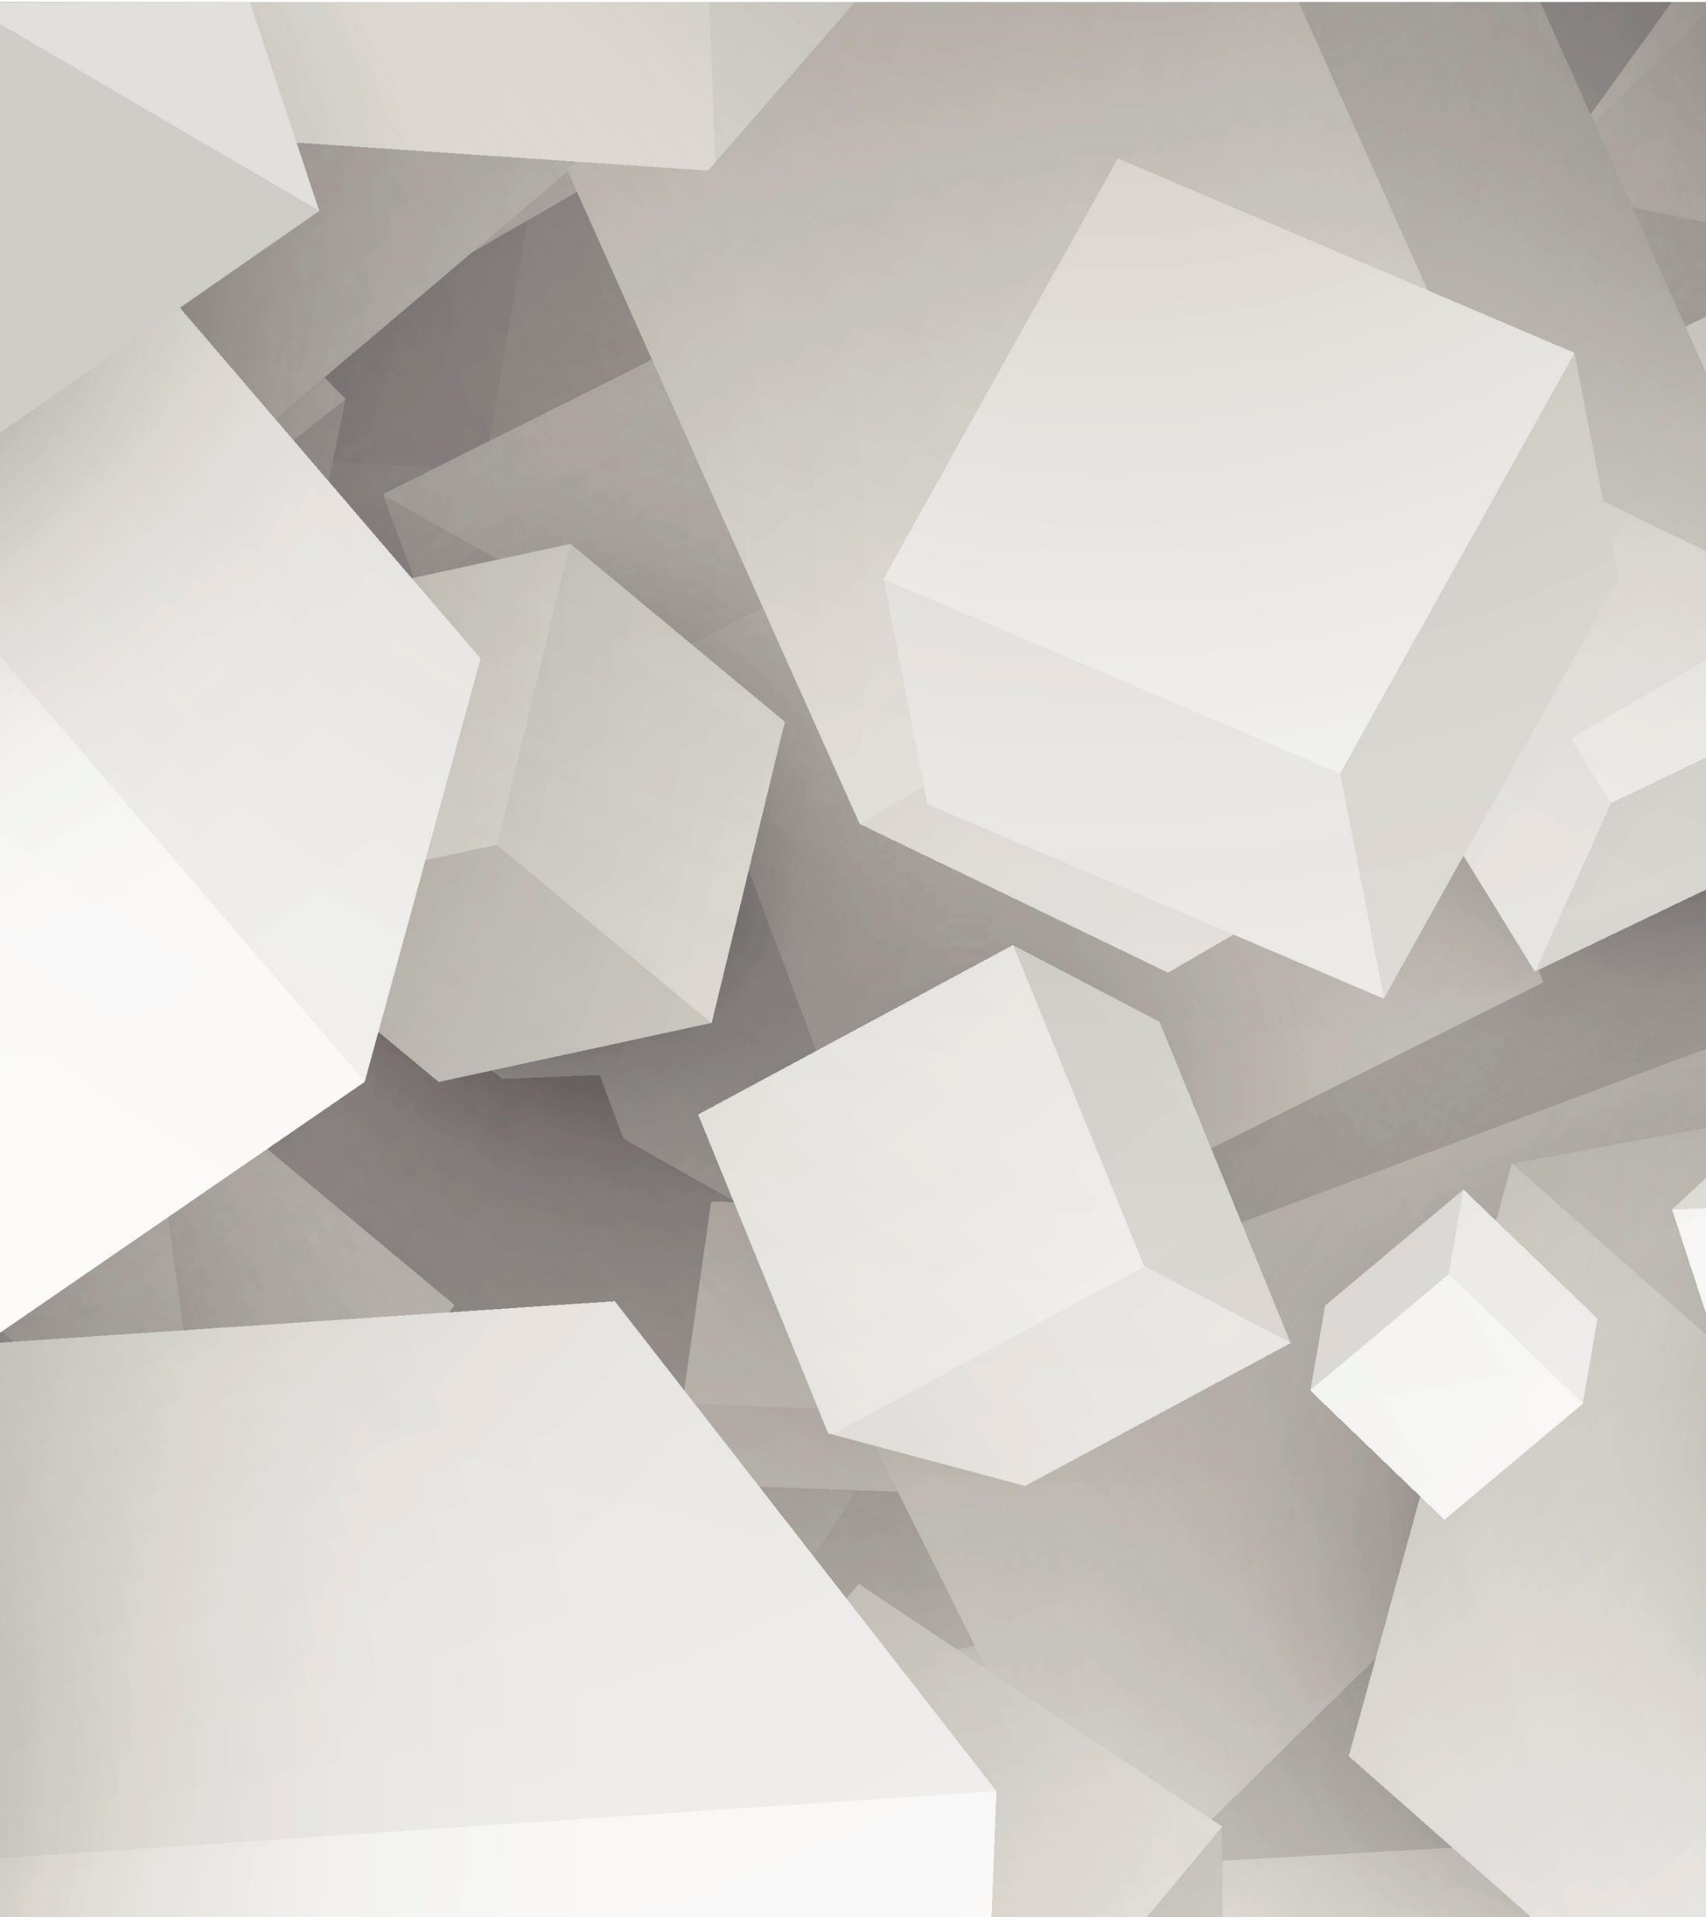

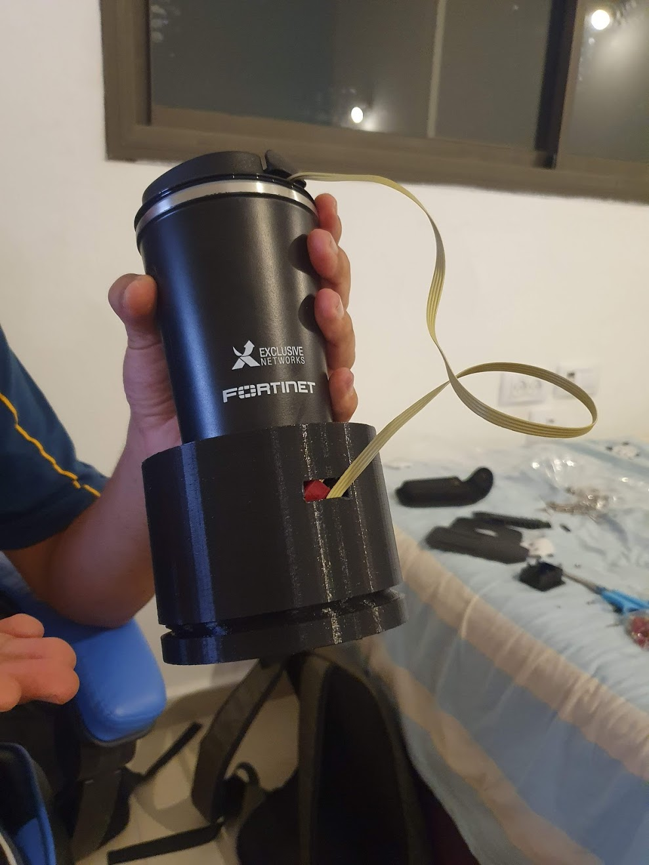
Introduction
Drinking enough water is an important part of leading a healthy life.
It makes our skin softer, raises our energy levels, lowers weight, increases brain activity and makes us healthier in general.

Slide 3
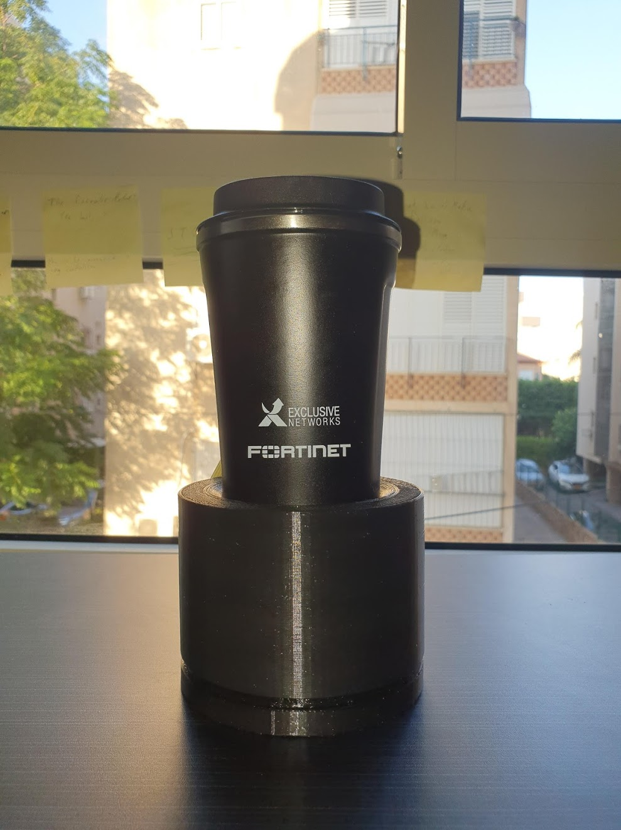
The product
In our day to day lives it can be hard to remember to drink enough water. We might forget to drink water for long periods of time when we’re at home, at the office or while traveling.
To help people maintain healthy drinking habits I have create the Smart Bottle!

Slide 4
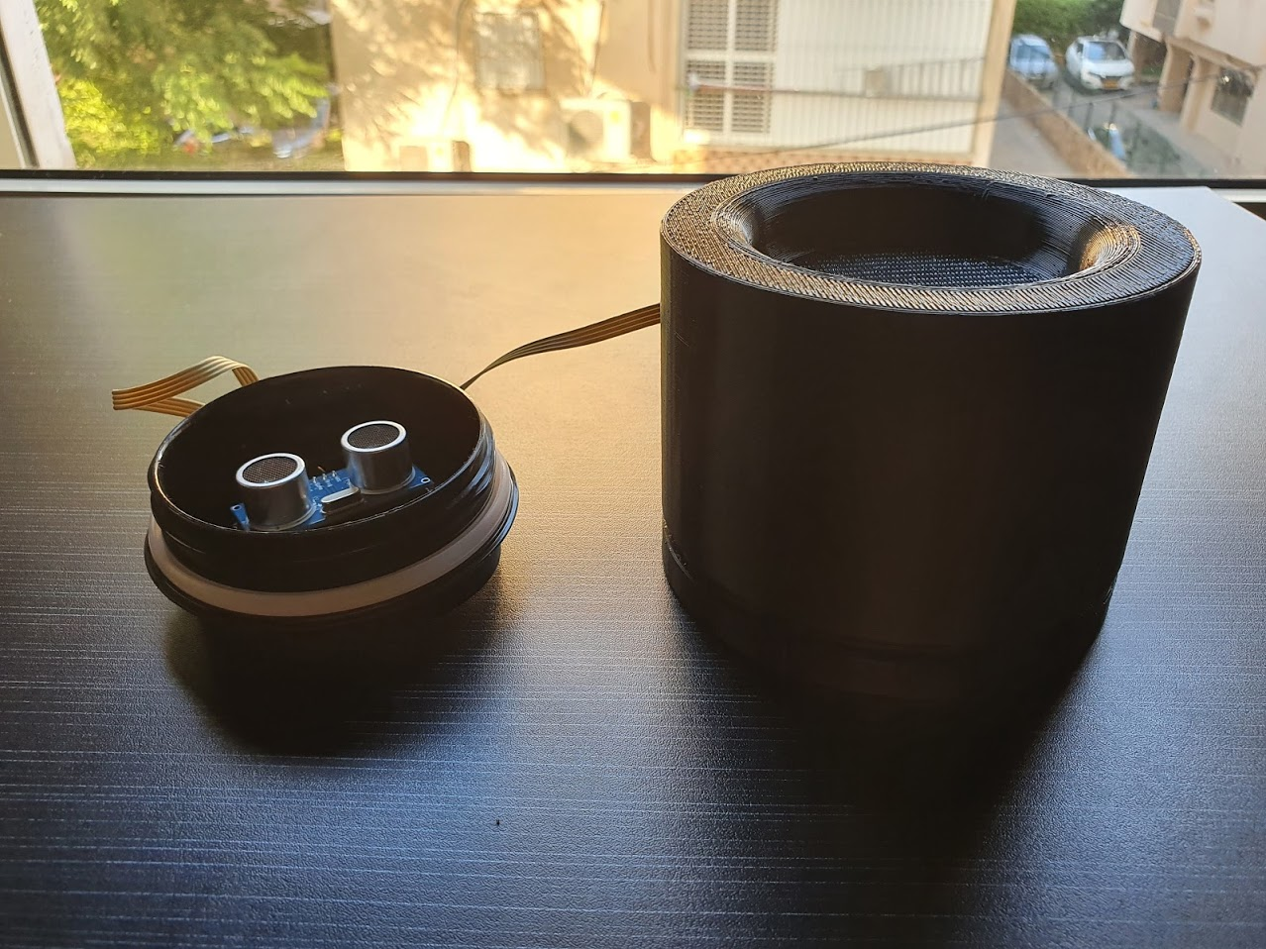
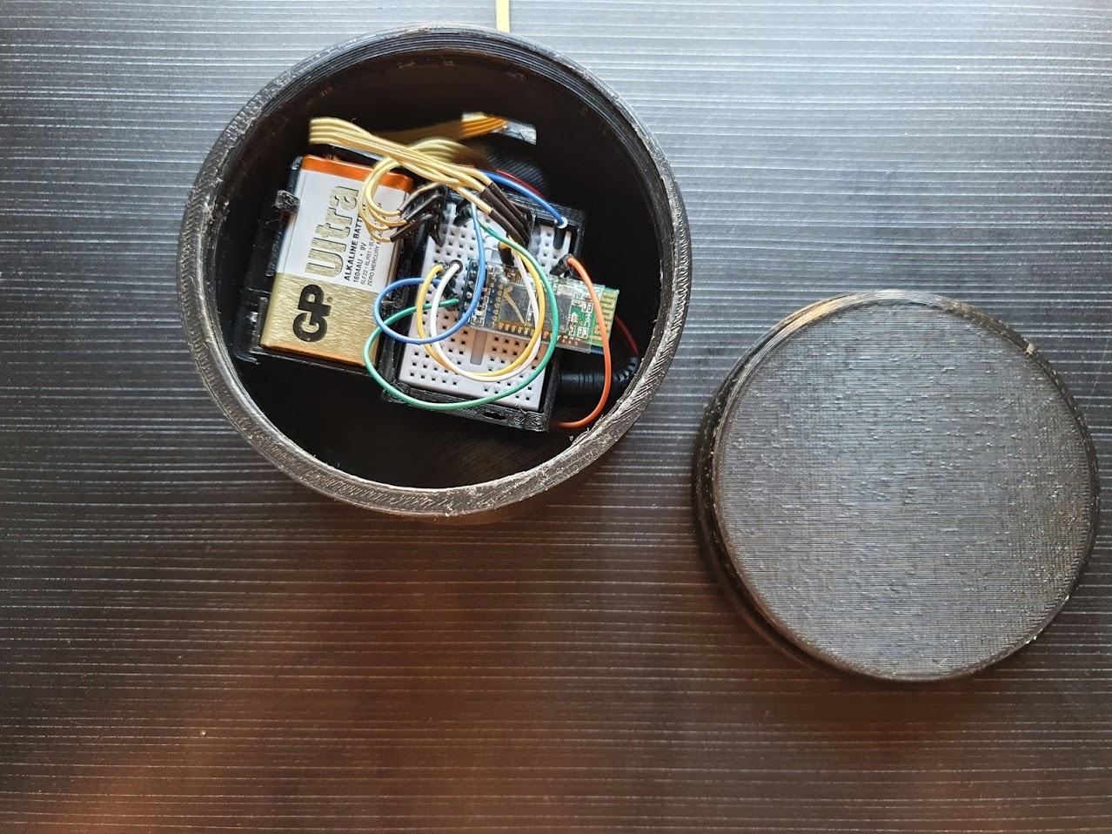
Functionality
The bottle keeps track of the user’s daily water consumption.
The bottle is connected to the user’s mobile device which shows him real-time data.
The bottle will send a notification to the user when a certain amount of time has passed since he last drank water.
The bottle keeps track of the amount of water in the bottle currently.
The app will transfer the bottle’s data to the cloud which will collect it and create analytics.

Slide 5
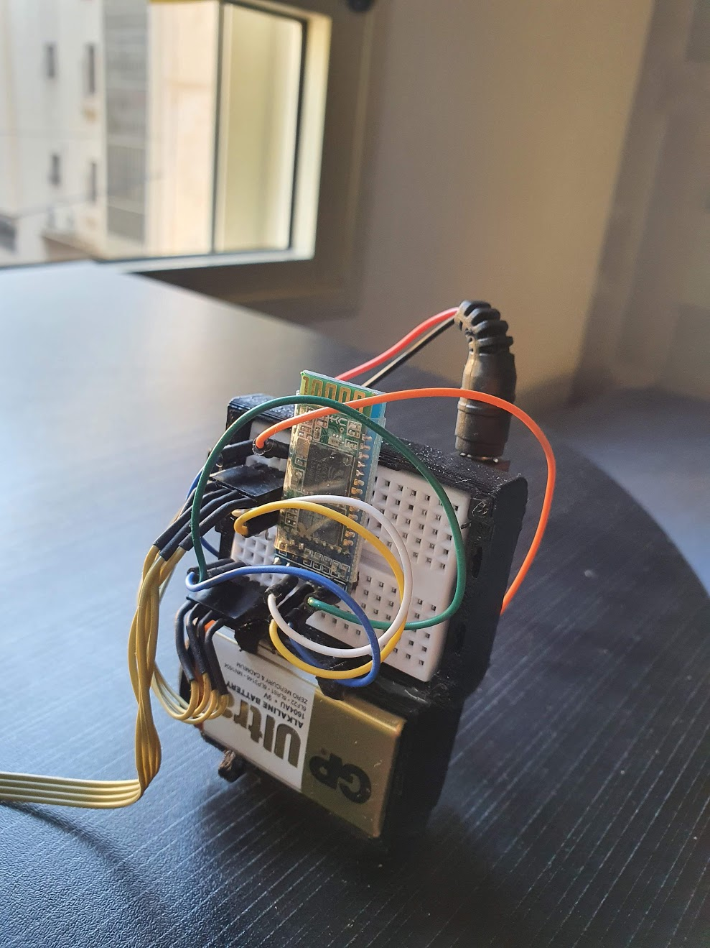
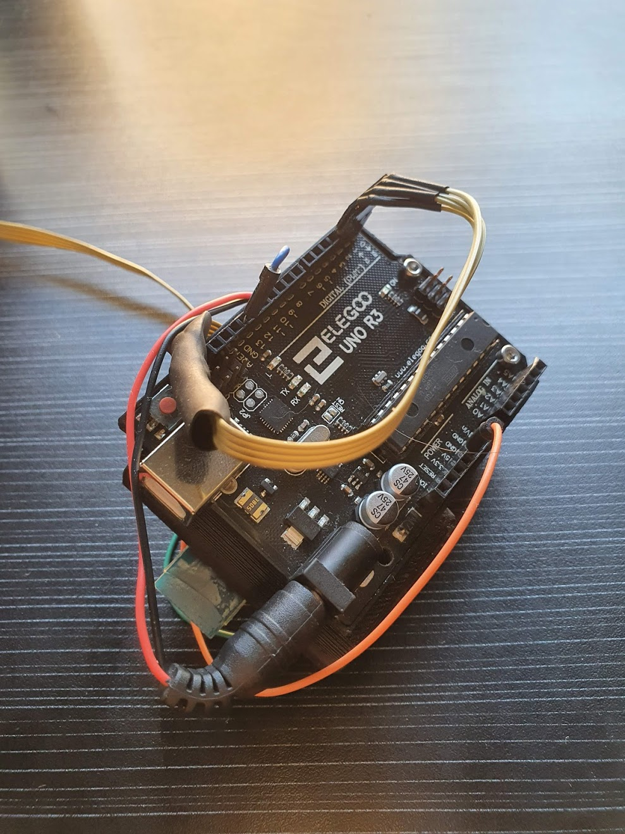
How is it built
An Arduino Uno R3
HC-05 Bluetooth Module
HC - SR04 Ultrasonic Sensor
Mini Breadboard
3D Printed “Cup Holder” & lid
3D Printed Electronics Case
9V Battery
Bottle Top
Bottle

Slide 6
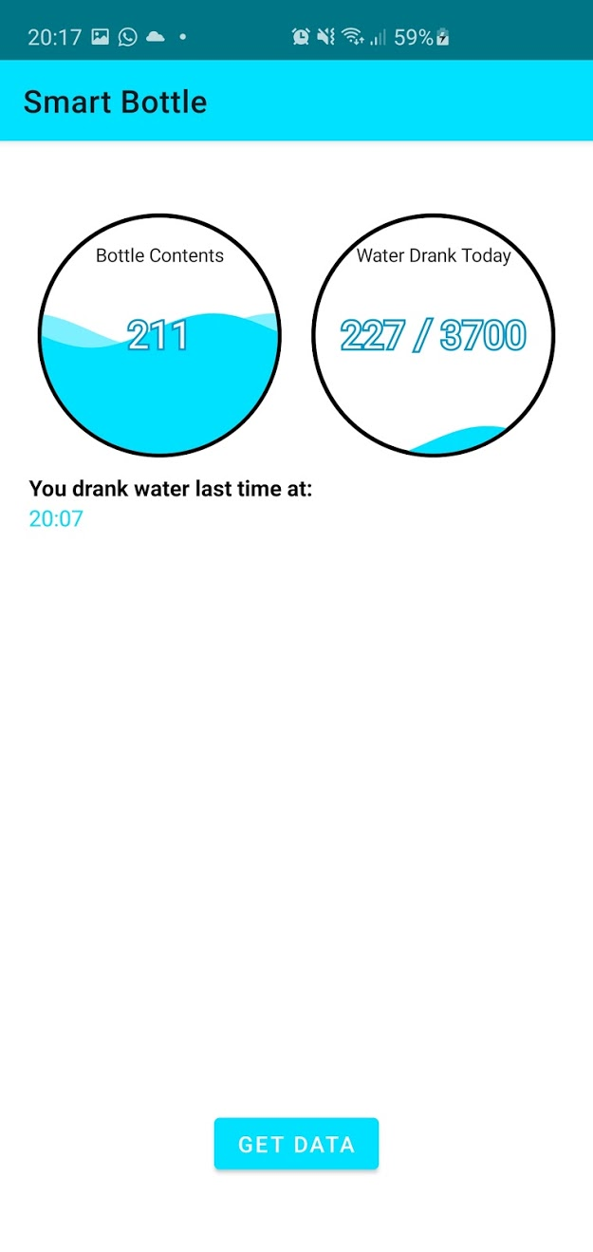
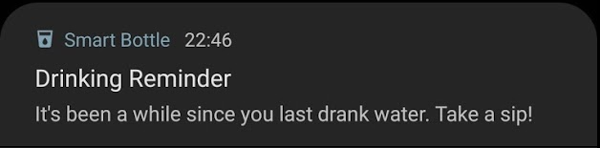
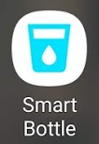
The App
The Smart Bottle companion app connects to the product and at the press of a button it gets data from the bottle and displays it beautifully to the user.
The app also sends data to the cloud service which follows both the water amount and the user’s water drinking.

Slide 7
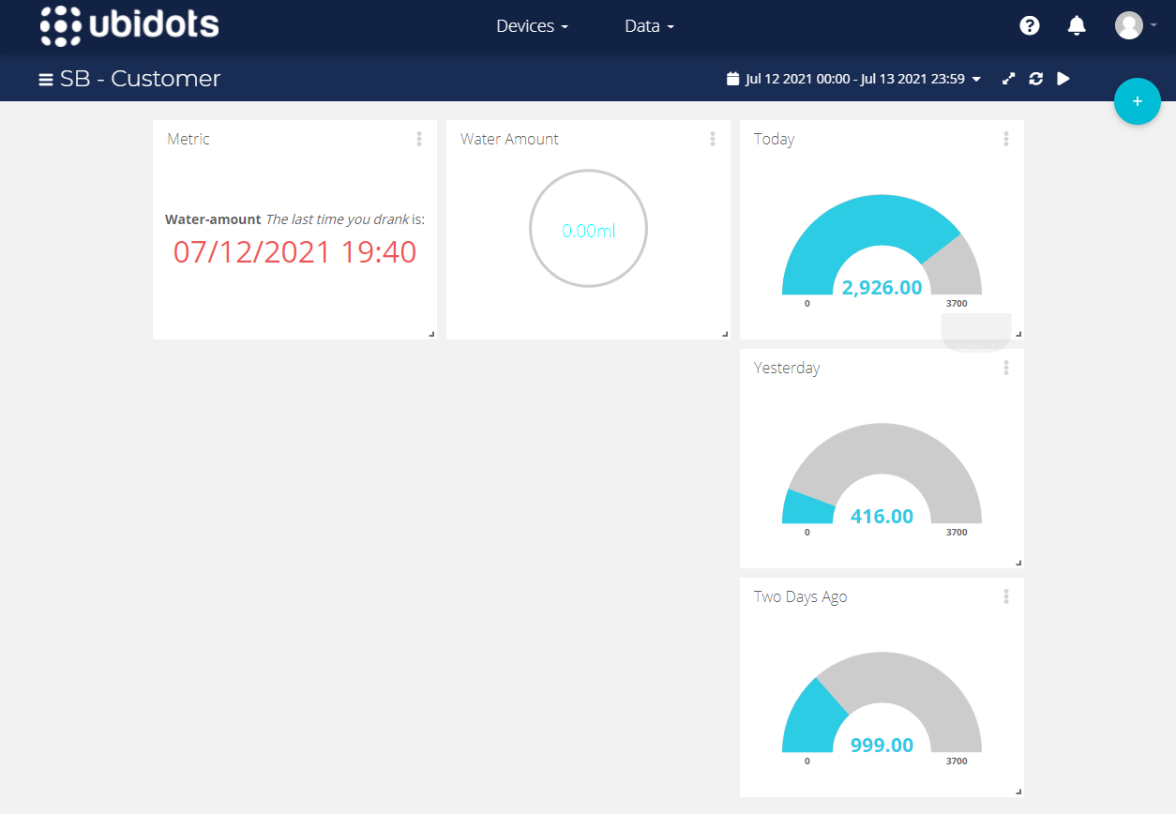
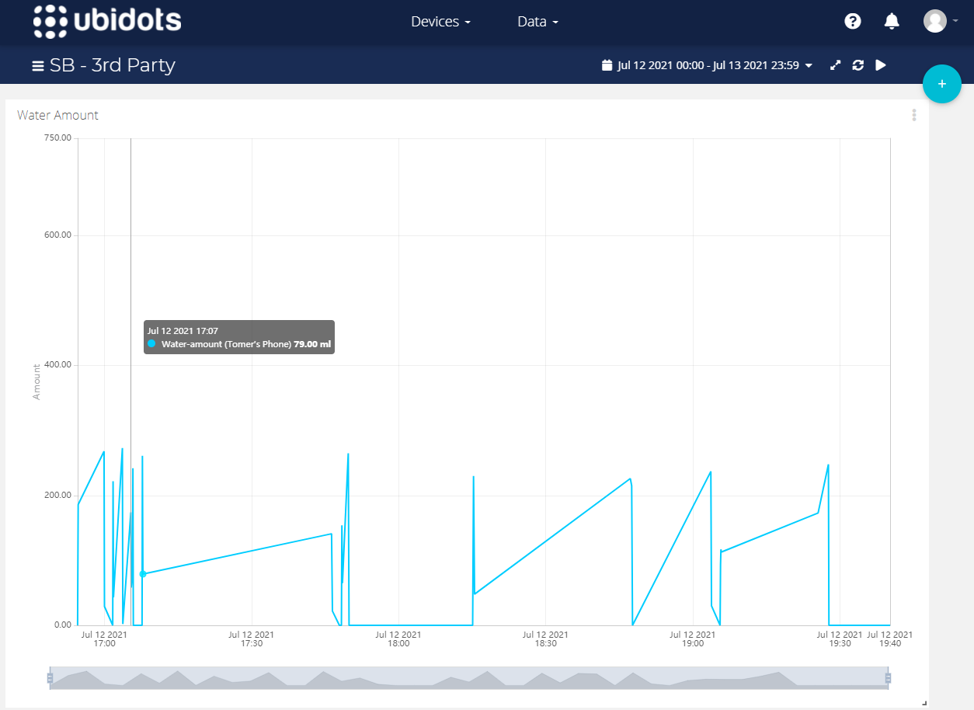
Cloud & Analytics
The Smart Bottle companion app will send the drinking amount and the current water amount in the bottle to the Ubidots cloud.
The cloud will have a dashboard for the user and another dashboard for 3rd party users(i.e., doctor, water suppliers etc.)

Slide 8
Thank you!
It has been a pleasure to create the smart bottle.
Hopefully, you will have as much pleasure using it as I did create it.

